Slide 1
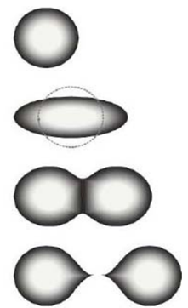
Fission Reactions
Fission may be defined as the process of splitting an atomic nucleus into fission fragments
The fission fragments are generally in the form of smaller atomic nuclei and neutrons
Large amounts of energy are produced by the fission process

Slide 2
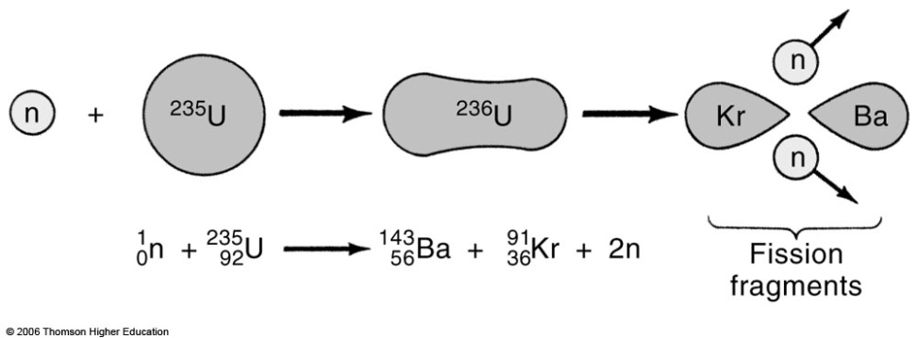
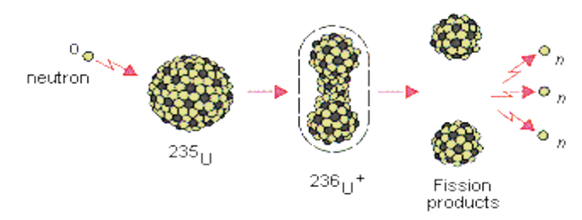
Fission Reactions

Slide 3
Fission Reactions
Some Examples of Fission Reactions
²³⁵₉₂U + ¹₀n →¹⁴¹₅₆Ba + ⁹²₃₆Kr + 3 ¹₀n +Energy
²³⁵₉₂U + ¹₀n →¹³¹₅₀Sn + ¹⁰³₄₂Mo + 2 ¹₀n +Energy ²³⁵₉₂U + ¹₀n→ ¹³⁷₅₂Te + ⁹⁷₄₀Zr + 2 ¹₀n +Energy
²³⁵₉₂^{U} + ¹₀n →¹³⁸₅₄Xe + ⁹⁵₃₈Sr + 3 ¹₀n +Energy
²³⁵₉₂U + ¹₀n→¹⁵²₆₀Nd + ⁸¹₃₂Ge + 3 ¹₀n +Energy

Slide 4
Fission Reactions There are two types of fission reaction exist as:
(i) Spontaneous Fission
Spontaneous fission is a naturally occurring nuclear decay event that a few different elements undergo
Uranium and plutonium, which are radioactive, are the most well known of the fissionable elements, and they can do this in nature
(ii)Induced Fission
Nuclear fission can be induced by bombarding atoms with neutrons.
The nuclei of the atoms then split into 2 equal parts.
Induced fission decays are also accompanied by the release of neutrons.

Slide 5
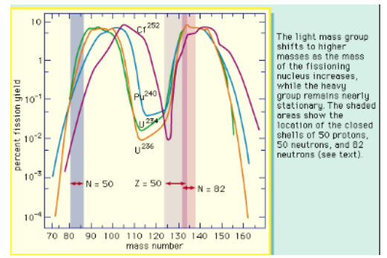
Important Characteristics of Fission Reactions Mass Distribution of Fragments

Slide 6
Important Characteristics of Fission Reactions Mass Distribution of Fragments
Fission fragments have a double bell distribution as a function of A (Mass Number).
Note that they are unstable, as are neutron rich they decay towards stable nuclei by a chain of beta decays.
This yields the so called “fission products”.

Slide 7
Number of Emitted Neutrons
(i) Prompt Neutrons: They are those accompanying the two nuclear fragments as the 2n in
²³⁵U+n→ ⁹³Rb + ¹⁴¹Cs+2n
In the case of 235U, there are on the average 2.42 prompt neutrons
(ii) Delayed Neutrons: These are associated with the beta decay of the fission products. Delayed neutrons are essential for the control of nuclear reactors.

Slide 8
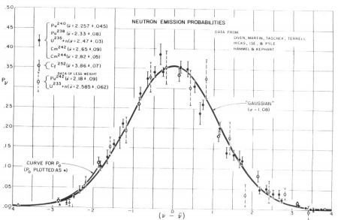
Number of Emitted Neutrons

Slide 9
Number of Emitted Neutrons
Distribution of fission neutrons.
Even though the average number of neutrons ν changes with the fissioning nucleus.
The distribution about the average is independent of the original nucleus.

Slide 10
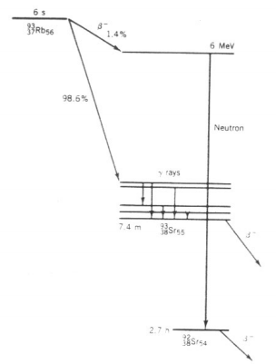
Number of Emitted Neutrons Delayed Neutron Emission from ⁹³Rb(Rubidium)

Slide 11
Number of Emitted Neutrons Delayed Neutron Emission from ⁹³Rb(Rubidium)
Delayed Neutron Emission from ⁹³Rb.
After the original β decay, the excited state of ⁹³Sr has enough
energy to decay by neutron emission to ⁹²Sr(Strontium).
The neutrons are delayed relative to the prompt fission neutrons by a time characteristic of the mean lifetime of ⁹³Rb

Slide 12

Radioactive Decay Processes
The initial fission products are highly radioactive and decay toward stable isobars by emitting many β and γ radiations(which contribute ultimately to the total energy release in fission).
These radioactive products are the waste products of nuclear reactors.

Slide 13
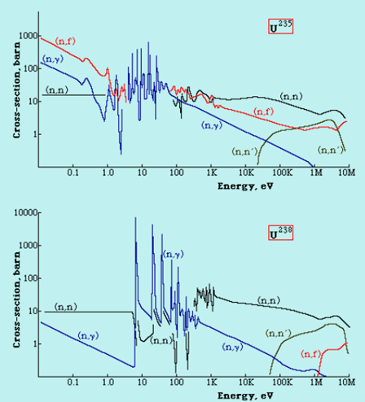
Fission Cross-section

Slide 14
Fission Cross-section
²³⁵U will fission (n,f) at all energies of the absorbed neutron.
²³⁵U fission cross section can grow Very large, to 500 barns sat thermal energies
²³⁸U has a threshold for fission (n, f) at a neutron energy of 1 MeV
There is very strong resonant capture of neutrons (n, γ) for energies in the range 10-100 eV - particularly in the case of 238U where the cross-section reaches very high values.

Slide 15
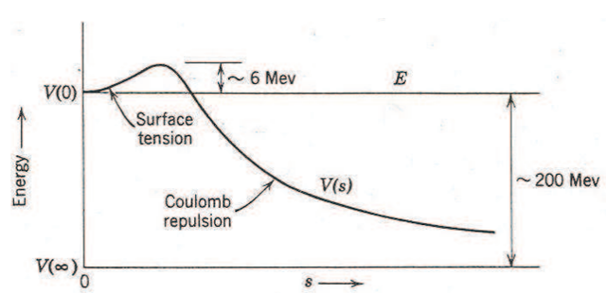
Energy in Fission
The excitation energy is
E_{ex} = [m (²³⁶U*) –m (²³⁶U)] c² = 931.50 MeV/u = 6.5 MeV
The activation energy =6.2 MeV

Slide 16
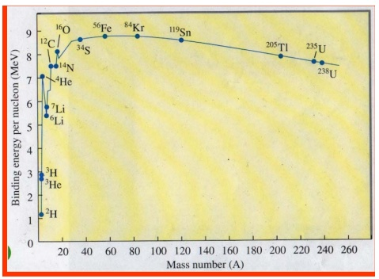
Energy in Fission
Binding energy for a nucleus ^{A}_{Z}X is Q (Z,N)=[Zm_{p} +Nm_{n} − m(^{A}_{Z}X)]c²
Typical Fission events Release 200 MeV
For ²³⁵U: ~235 MeV

Slide 17
Controlled Fission Reactions Neutron Multiplication factor(k)
The effective neutron multiplication factor, k, is the average number of neutrons from one fission that causes fission:
k=(Number of Neutrons in one generation)/ (Number of neutrons in preceding generation)
The remaining neutrons either are absorbed in non-fission reactions or leave the system
without being absorbed.

Slide 18
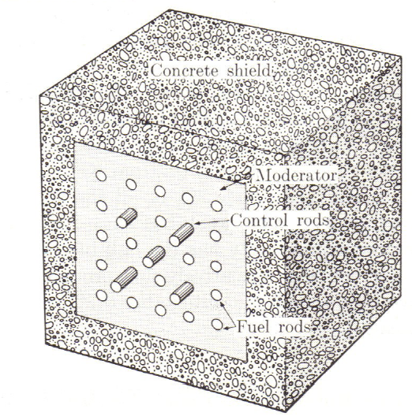
Controlled Fission Reactions Neutron Multiplication factor(k)
The value of k determines how a nuclear chain reaction proceeds.
k ≥ 1  Chain reaction
k < 1  subcritical
k = 1  critical system
k > 1  supercritical
For steady release of energy (steady- state operation) we need k =1
Chain reacting pile

Slide 19
Controlled Fission Reactions Four –factors formula
Neutron multiplication factor in an infinite medium k∞
k∞=ηfpɛ (Four-factor formula)
η- reproduction factor - the number of fission neutrons produced per absorption in the fuel
f - the thermal utilization factor - probability that a neutron that gets absorbed does so in the fuel material
p - the resonance escape probability - fraction of fission neutrons that manage to slow down from fission to thermal energies without being absorbed
ɛ- the fast fission factor = (Total Number of fission neutrons)/(Number of fission neutrons from just thermal fission)

Slide 20
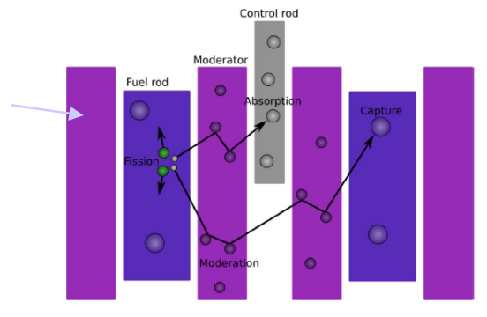
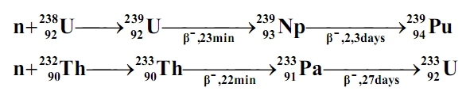
Fuel Use in the Reactor
In nature there are only 3 isotopes - ²³⁵U, ²³⁸U and ²³²Th –which can be used as nuclear fuel (²³⁵U) or reproduction of fuel (as ²³⁸U →239Pu; ²³²Th →²³³U ). Naturally occurring uranium consists 99.3% of ²³⁸U and only 0.7% of ²³⁵U i.e. for 1 nucleus of ²³⁵U there are 140 nuclei of ²³⁸U.

Slide 21
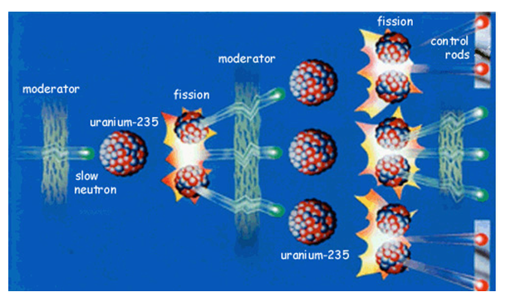
Moderator
In nuclear reactors there are neutron moderators, which reduce the velocity of fast neutrons, thereby turning them into thermal neutrons.
The following substances are commonly used as moderators.
graphite,
H₂O, D₂O
He
Be (high temperature liquid metal).
Na (773 to 873 K used in breeder reactor)
BeF₂ + ZrF₄ (for GCR)

Slide 22

Absorber
A control rod is a rod made of chemical elements capable of absorbing many neutrons without fissioning themselves. They are used in nuclear reactors to control the rate of fission of uranium and plutonium.
Usually, Cadmium, Boron, Carbon, Cobalt, Silver, Hafnium, Gadolinium and Europium are common elements used in control rods.

Slide 23
Types of Nuclear Reactors
There are very many different types of nuclear reactors with different fuels, coolants, fuel cycles, purposes.
Pressurized Water Reactor
Boiling Water Reactor
Sodium Cooled Fast Reactor
Canada Deuterium-Uranium Reactors (CANDU)
Liquid Fluoride Thorium Reactor
High Temperature Gas Cooled Reactor

Slide 24
Advantages of Nuclear Power
Nuclear electricity is reliable and relatively cheap (with an average generating cost of 2.9 cents per kW/h) once the reactor is in place and operating.
A lot of energy is generated from a single power plant
Nuclear power plants contribute no greenhouse gasses and few atmospheric pollutants

Slide 25
Disadvantages of Nuclear Power
Uranium is ultimately a nonrenewable resource.
Nuclear power plants are extremely costly to build.
The slight possibility that nuclear power plants can have catastrophic failures.
Large environmental impact during the mining and processing stages of uranium are numerous.
Nuclear waste (Spent nuclear fuel) is extremely hazardous and must be stored safely for thousands of years.

Slide 26
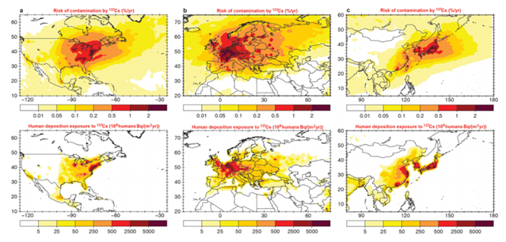
Conclusions
Environmental Impacts
Waste Management’s:
Sustainability
Accidents

